Slide 1
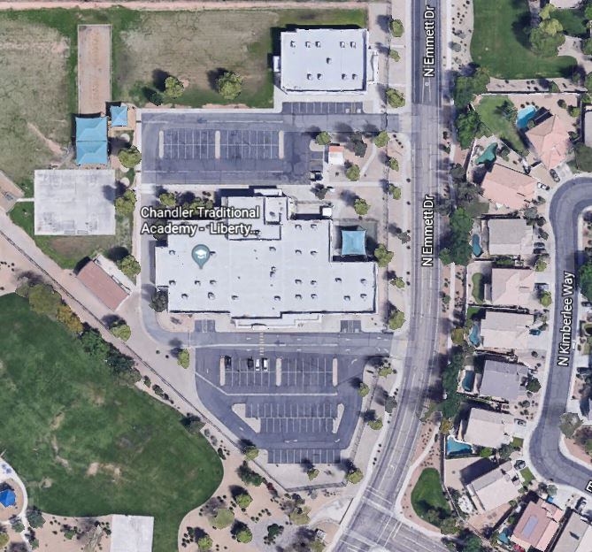
PreK Parent Pick-Up and Drop-Off Map and Instructions
PreK School Hours: 8:00 am to 2:30 pm
Drop off in the morning is no earlier than 7:45 am
*Drop off for students with extended care is 7:00 am and pick up no later than 5:30 pm
*Parents must park and sign students in and out of the PreK classrooms.
Drop Off/Pick Locations for PreK is the South (Front) Parking Lot.
After 7:45 am parents must wait the in the drop-off line to park.
After 2:30 pm, parents must wait in the drop-off line to park.
Please DO NOT block any crosswalks or handicap stalls.
Please DO NOT use cell phones while waiting in line or driving through the parking lot.
NORTH STAFF ONLY
SOUTH
South (Front) Parking Lot: Left Turns Only to Enter Lot. Right Turns only Allowed to Exit lot.

